Slide 1
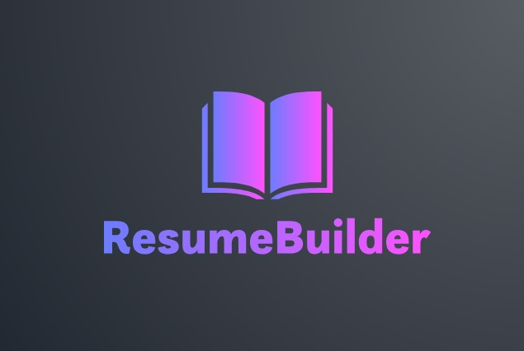

“Laying the foundation and structure to your future”
by Coral S. Schmidt Montilla, Jaime J. Cuebas Ruiz, Christopher Ortiz, Christian Brito & Taishali N. Jimenez Quiñones

Slide 2


Problem
Market gap
Many job seekers struggle to create professional resumes, and existing tools are often outdated, complex, or costly.
Customers
Job seekers and interns need a free and easy-to-use resume builder to improve their chances in an increasingly competitive market​.
Financials
The demand for recruitment technology is rising, with companies investing heavily in hiring and resume-screening solutions [HiringThing].
Costs
Most resume-building platforms charge a fee or limit free access, while our solution aims to remain free through a university partnership​.
Usability
Users need a simple, intuitive solution that ensures their resumes are customizable, professional, and ATS-compliant​.

Slide 3
Solution
Close the gap
Our product makes managing tasks easier, and no other product on the market offers the same benefits.
Cost savings
Reduce costs for client by helping project managers stay on target within deadlines.
Target audience
Job seekers, students, and interns who need professional, customizable resumes without struggling with outdated or costly alternatives​.
Easy to use
A guided, step-by-step interface with pre-designed templates, smart suggestions, and real-time resume feedback, ensuring a seamless and efficient user experience​.
Cloud Storage & Accessibility
Users can save, edit, and download their resumes from any device​.
Security & Reliability
Secure authentication and cloud-based backups ensure data safety and easy retrieval.​
API Integration
Pulls job-specific recommendations to tailor resumes based on industry trends​.

Slide 4
Resume Statistics

Slide 5

What Is Our Product?
Easy-to-use app for building professional resumes
Step-by-step guidance to help users fill out each section
Job-specific recommendations based on industry needs
Customizable templates for a polished, professional look
Cloud storage & instant downloads for easy access anytime
Designed for students, job seekers, and professionals

Slide 6



Our competition
ResumeGenius & ResumeBuilder.com:
Strengths: Allows flexible resume design with drag-and-drop customization.
Resume.com
Strengths: Free and allows users to store past resumes.
Canva
Weaknesses: Lacks ATS optimization, meaning resumes may get rejected by hiring software.
Our Advantage: We provide both customization and ATS-friendly formatting.
Strengths: Provide structured resume-building guidance and template customization.
Weaknesses: Charge users upon completion, restricting access unless they pay.
Our Advantage: We offer the same structured guidance without hidden fees.
Weaknesses: Lacks guided resume-building and customized job recommendations.
Our Advantage: We offer a free service with AI-driven suggestions and industry-specific recommendations.

Slide 7
Why we stand out
Combines the best of all competitors
Structured guidance like ResumeGenius, flexibility like Canva, and free access like Resume.com.
No payment barriers
Unlike ResumeGenius, our users never have to pay to download their resumes.
AI-powered customization
Unlike Canva, our resumes are optimized for ATS, ensuring better job application results.
Seamless user experience
Unlike Resume.com, our builder guides users with smart suggestions to maximize resume quality.

Slide 8



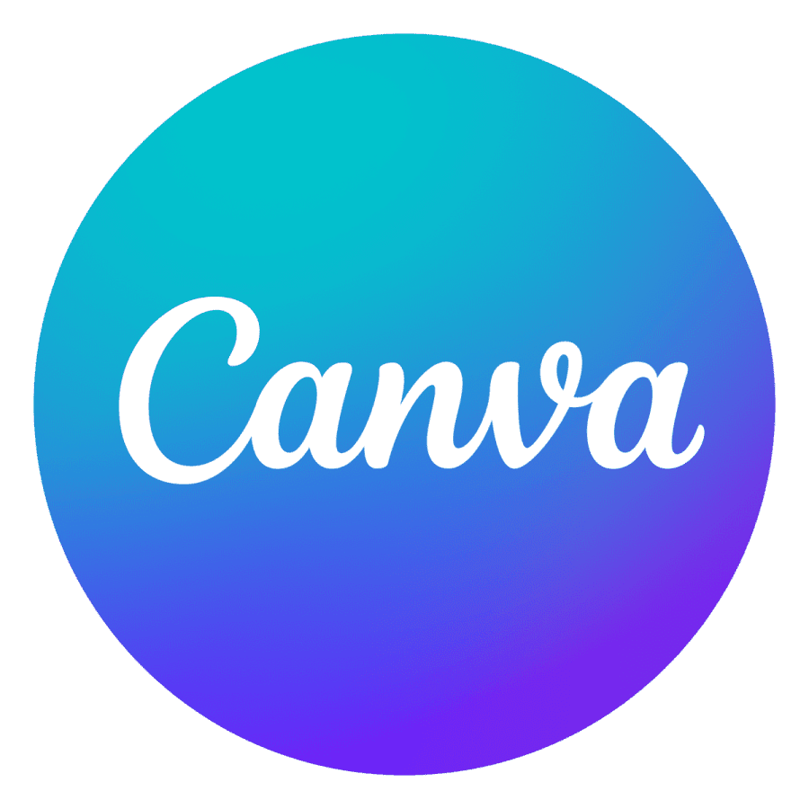

Competition
Convenient
Expensive
Affordable
Inconvenient

Slide 9
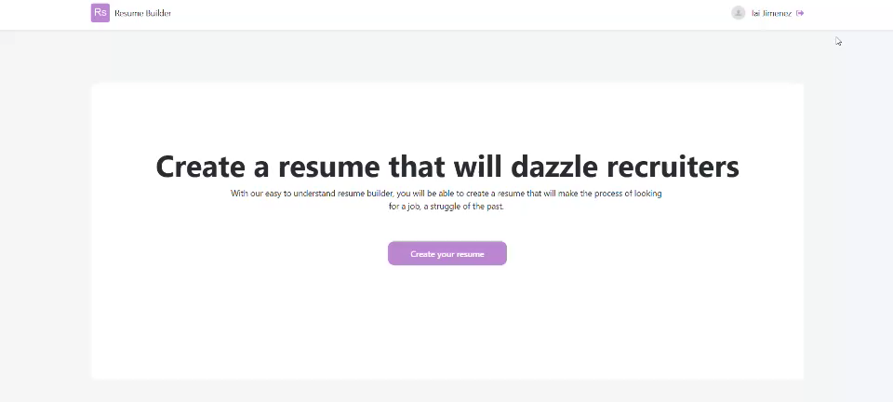
Product Demo

Slide 10
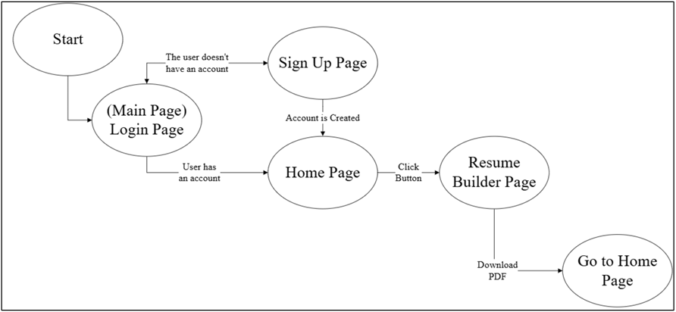
User Interfaces

Slide 11
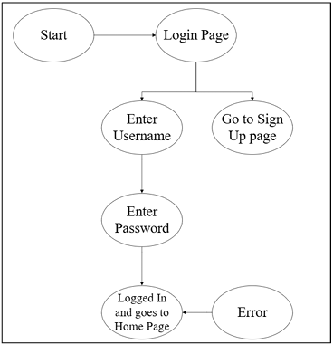
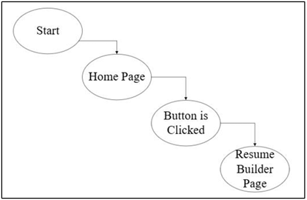
User Interfaces
Home Page State Diagram
Main Page State Diagram

Slide 12
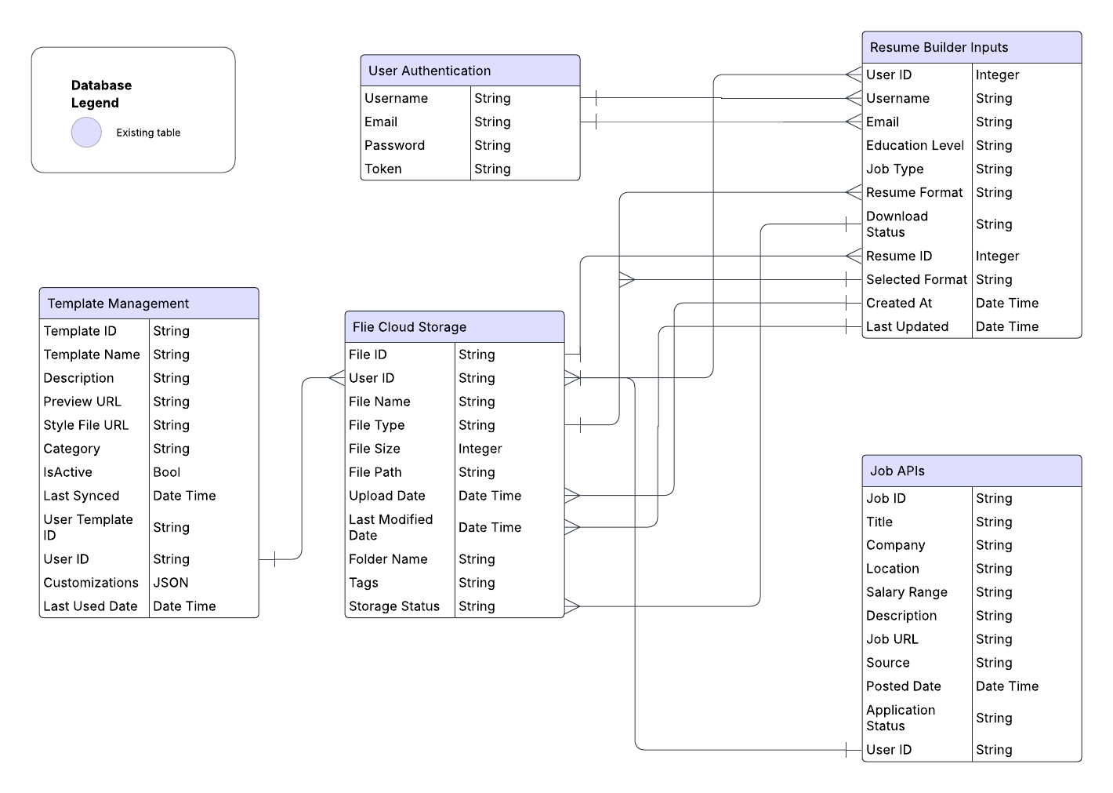
Database Infrastructure
Good database management and infrastructure is extremely important for us for better Organization and overall workflow throughout our app

Slide 13
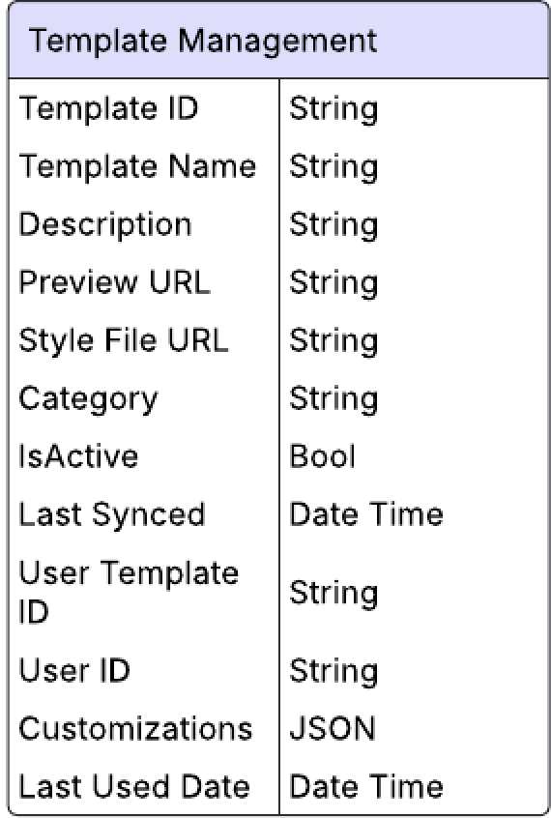
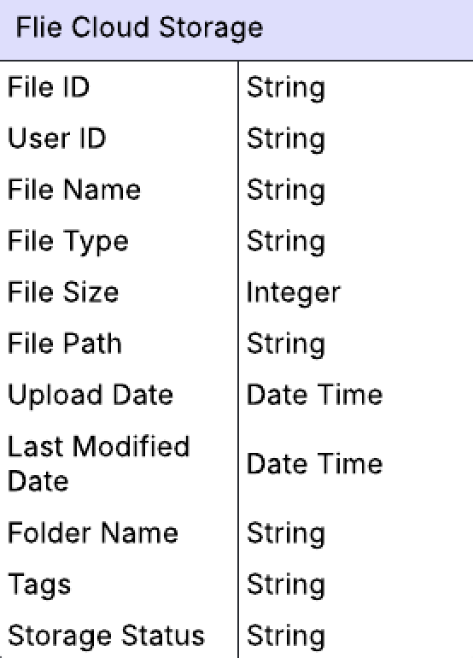
Database Schema Entities & Attributes
Template Management Table
File cloud storage table

Slide 14
Project schedule

Slide 15
Why we chose OutSystems?
Integration Power: Seamlessly connects with databases, APIs, and services.
Cross-Platform Compatibility
Security & Maintainability: Built-in architecture governance and security checks.
Enterprise-Grade Protection
Role-Based Access Control (RBAC)
AI-Driven Security
Automated Maintenance
Enterprise-Grade Apps: Supports scalable, cloud-native applications.
Scalability
Auto-Scaling
Serverless Efficiency
Multi-Cloud & On-Prem​.
Develop applications 7x faster with reusable components.
Eliminate Repetitive Coding
Visual Development
Drag-and-Drop Logic
The industry recognizes OutSystems as a top-tier development platform.
Trust & Reliable
OWASP Compliance
Full Security Visibility
Rapid Deployment
Strong Community Support
Continuous Innovation
API Integration
Direct Database Access
Custom Connectors

Slide 16
Proving Our Skills as Developers
OutSystems has custom C#, JavaScript, and APIs.
A major misconception is that low-code development means no real programming.
Advanced Development Incorporating AI, complex UI/UX, and cloud services.
Applications today require AI integration, modern UI/UX designs, and cloud capabilities.
Following best practices like modularization and service-oriented architecture.
Proper software design ensures maintainability, scalability, and efficiency.
It enhances our development capabilities, not limits them
Skeptics believe that low-code platforms reduce programming control.

Slide 17

Questions?

Slide 18

References
Brothwell, Pat. “Applicant Tracking Systems Aren’t Excluding Job Applicants—People Are.” Hiringthing.com, HiringThing, Inc., https://blog.hiringthing.com/applicant-tracking-system-myths. Accessed 29 Jan. 2025.
---. “Why All Businesses Can Benefit from Applicant Tracking Systems.” Hiringthing.com, HiringThing, Inc., https://blog.hiringthing.com/all-businesses-benefit-from-ats-use. Accessed 29 Jan. 2025.
Outsystems. “7 Myths about Low-Code—Debunked.” Outsystems.com, Outsystems, 2024, www.outsystems.com/1/low-code-myths/. Accessed 29 Jan. 2025.
---. “Comparison: Why OutSystems vs. Low-Code Alternatives.” Outsystems.com, Outsystems, 2024, www.outsystems.com/1/outsystems-vs-alternatives/. Accessed 29 Jan. 2025.
---. “Low-Code Doesn’t Mean Low-Control.” Outsystems.com, Outsystems, 2024, www.outsystems.com/1/low-code-faqs/. Accessed 29 Jan. 2025.
---. “Low-Code for pro Developers: Enhance Your Coding Skills.” Outsystems.com, Outsystems, 2024, www.outsystems.com/1/app-development-guide/. Accessed 29 Jan. 2025.

Slide 19
References
Andrei Kurtuy. (2023, May 16). 99+ Must-Know Resume Statistics To Get You Hired in 2025. Novorésumé; Novorésumé ApS. https://novoresume.com/career-blog/resume-statistics
‌Zigic, Drazen. “Closeup of a Member of Human Resource Teal Reading Candidate’s CV during the Meeting in the Office.” Freepik.com, Freepik, 2025, www.freepik.com/free-photo/closeup-member-human-resource-teal-reading-candidate-s-cv-meeting-office_26390643.htm#fromView=keyword&page=1&position=8&uuid=d1fde296-9ac8-4d51-a059-9a471a9e7457&query=People+Resume. Accessed 28 Jan. 2025.
Freepik. “Free Vector | Choice of Worker Concept.” Freepik.com, Freepik, 2020, www.freepik.com/free-vector/choice-worker-concept_9544570.htm#fromView=keyword&page=1&position=4&uuid=d1fde296-9ac8-4d51-a059-9a471a9e7457&query=People+Resume. Accessed 28 Jan. 2025.

